Slide 1
The Mining and Automotive Skills Alliance
Donna Dejkovski – Manager Training Products
Eleanor Yeoell – Senior Training Product Development Lead
21 November 2024
Notes:
Title Slide – Design A
Inputs:
Title
Subtitle
Presenter Name
Date

Slide 2
AUSMASA
Who are we?
We are the Jobs and Skills Council for the mining and automotive industries.
Jobs and Skills Councils (JSCs) have been established by the Australian Government to deliver a collaborative, tripartite VET sector that brings employers, unions and governments together to find solutions to skills and workforce challenges.

Slide 3
Workforce Plan 2024 – Moving Ahead Together
Topics covered include:
Higher education pathways
Skilled migration and international students
Industry culture and workforce diversity
First Nations engagement
Mentoring of apprentices
Technological advancement
Pay, role classification and scaffolding of learning
Digitisation and automation

Slide 4
AUSMASA Current AAS Projects
Resource Development: Certificate II in Autonomous Workplace Operations
Review and update of the RII emergency response qualifications
Training package review of superseded units of competency
Review into VET training products with low and no enrolments
Market research into youth perceptions of automotive careers
Development of hydrogen fuel cell EV training products
Review of the Certificate II in Automotive Tyre Servicing Technology
Review of Emergency Response training products (RII)
Development of training products for ADAS
Review of 6 RII units shared with BuildSkills

Slide 5
AUSMASA projects - other
11. VET Workforce Blueprint
12. Research into higher apprenticeships (automotive & mining)

Slide 6
Perceptions of Automotive Careers
Understanding attraction and retention in the automotive industry
Phase 1 Findings

Slide 7
Market Research Activity Objectives & Methodology
Objectives
Audiences
Methodology
The overarching objective of this program of work is to draw together insights around how best to attract and retain automotive tradespeople from all relevant stakeholder groups. The resulting insights will then form the basis for a portfolio of resources that can be used in relevant settings to advocate for the automotive industry over competing alternatives.
Specifically, insights will be used to:
Uncover the perceptions priority cohorts, including Gen Z and existing workers, have of the automotive sector and associated careers.
Understand the intentions of existing workers in the automotive sector with regards to staying or exiting the industry.
The insights presented in this report are from Phase 1, with Phase 2 to follow in due course.
All three audiences were surveyed using an online quantitative methodology.
High School Students & Career Starters:
10-minute survey
Sample sourced using a specialist consumer research panel
Those aged 15 or younger completed the survey with parental assistance
Quotas set by age, gender and location
Survey data weighted to national proportions based on age, gender and state
Current Auto Workers:
10-minute survey
Survey distributed to current auto workers directly via industry partners and indirectly via social media
Survey data unweighted
High School Students
n=1,000 13–18-year-olds who are still in school or an alternative educational pathway
n=1,000 young adults (aged 17-25), who are no longer at school, but open to considering the automotive industry (i.e. non-rejectors)
Career Starters
Current Auto Workers
n=613 current automotive industry workers

Slide 8
What interests you the most about a career in the automotive industry?
Career
Starters
Total Post School
At University
Vocational Training*
Currently Working
Technical & Mechanical Interests
Good for Career
Passion
Sustainability
* Low base
C7. What interests you the most about a career in the automotive industry?
Base: All Post School (n=1,000), At University (n=356), On a Course (n=33), Currently Working (n=557)

Slide 9
What concerns would you have about pursuing a career in the automotive industry?
High
School
Total High School
NSW/ACT
VIC/TAS
QLD
SA/NT
WA
Career-Related
Health & Safety
Work Environment
Male Dominated
Sustainability
C8. What concerns would you have about pursuing a career in the automotive industry?
Base: All High School Students (n=1,000), NSW/ACT (n=345), VIC/TAS (n=273), QLD (n=184), SA/NT (n=103), WA (n=95)

Slide 10
More broadly, both male and female high school students have significant concerns about the physical nature of the industry, again suggesting a certain lack of understanding of what a technician does in 2024
High
School
What concerns would you have about pursuing a career in the automotive industry?
Highlighting indicates 10 percentage point or greater variation vs. total
Total High School
High School Males
High School Females
Career-Related
NET 58%
NET 63%
NET 52%
Health & Safety
NET 46%
NET 40%
NET 52%
Work Environment
NET 37%
NET 40%
NET 35%
Male Dominated
Sustainability
C8. What concerns would you have about pursuing a career in the automotive industry?
Base: All High School (n=1,000), High School Males (n=521), High School Females (n=475)

Slide 11
For regional career starters, limited local opportunities is a concern, especially amongst males, whilst metro career starters are more concerned about job instability
Career
Starters
What concerns would you have about pursuing a career in the automotive industry?
Career Starters
Career Starter Males
Career Starter Females
Highlighting indicates 10 percentage point or greater variation vs. total
Metro
Regional
Metro
Regional
Career-Related
Health & Safety
Work Environment
Male Dominated
Sustainability
C8. What concerns would you have about pursuing a career in the automotive industry?
Base: Career Starter Males – Metro (n=420), Career Starter Females – Regional (n=101), Career Starter Females – Metro (n=370), Career Starter Males – Regional (n=101)

Slide 12
Despite this, most of the women currently working in the automotive industry would recommend it as a career option to someone leaving school today
All
Audiences
Which, if any, of the following statements that others have made about the future of the automotive industry do you agree with?
Attitudes related to automotive careers
High School Students
Career Starters
Current Workers
Arrow indicates 10%+ variation between subgroups
D2. Which, if any, of the following statements that others have made about the future of the automotive industry do you agree with?
Base: High School Males (n=521), High School Females (n=475), Career Starter Males (n=521), Career Starter Females (n=471), Current Worker Males (n=516), Current Worker Females (n=71)

Slide 13
What is qualifications reform?
Unlocking the Potential of VET

Slide 14
Overview of the Qualifications Reform categorisation and demonstration activities
Purpose 1 Qualifications leading to a specific occupation (e.g. a licensed trade) |  | Purpose 2 Qualifications to prepare learners for multiple occupations within an industry |  | Purpose 3 Qualifications that develop cross-sectoral or foundation skills and knowledge which may be applied across industries, or lead to tertiary education and training pathways
Built around specific tasks, with a high level of prescription to support safety or technical requirements. Example Certificate III in Light Vehicle Mechanical Technology |  | Built around a common core of skills and knowledge for the industry, with optional specialisation. Example Certificate II in Construction Pathways |  | Built around general skills and knowledge, or specific skills and knowledge with cross-sectoral application. Example Diploma of Leadership and Management
Notes:
Table and Featured Number Slide – Navy Background
Inputs:
Title
Number
Subheads
Content

Slide 15
AUSMASA Qualifications Reform Projects
Rethinking Automotive Entry Pathways
AUR Demonstration Project
This project found 15 Certificate II qualifications within the AUR package have various levels of participation and enrolment and few lead to occupational outcomes.
The project tested a new approach to qualification design focused on identifying knowledge and capabilities required across related jobs in the industry and less on describing specific tasks.
The project was completed September 2024.
2. Categorisation Project
Categorisation Project
AUSMASA conducted a stocktake of our training products, categorising qualifications into one of the 3 purposes and applying the Design Groups’ Qualification Development Quality Principles with a view to simplifying and rationalising qualifications where possible.
The project was completed September 2024.

Slide 16
Final categorisation of 41 qualifications
Purpose 1 25 Qualifications leading to a specific occupation (e.g. a licensed trade) |  | Purpose 2 13 Qualifications to prepare learners for multiple occupations within an industry |  | Purpose 3 3 Qualifications that develop cross-sectoral or foundation skills and knowledge which may be applied across industries, or lead to tertiary education and training pathways
AUR20520 Certificate II in Automotive Servicing Technology AUR20220 Certificate II in Automotive Air Conditioning Technology AUR21920 Certificate II in Automotive Tyre Servicing Technology AUR30320 Certificate III in Automotive Electrical Technology AUR30420 Certificate III in Agricultural Mechanical Technology AUR30520 Certificate III in Marine Mechanical Technology [full list provided in final report] |  | AUR10120 Certificate I in Automotive Vocational Preparation AUR30920 Certificate III in Motor Sport Technology AUR40116 Certificate IV in Automotive Management AUR40216 Certificate IV in Automotive Mechanical Diagnosis AUR40320 Certificate IV in Motor Sport Technology AUR40720 Certificate IV in Automotive Body Repair Technology [full list provided in final report] |  | AUR30116 Certificate III in Automotive Administration AUR50116 Diploma of Automotive Management AUM50113 Diploma of Automotive Manufacturing
Notes:
Table and Featured Number Slide – Navy Background
Inputs:
Title
Number
Subheads
Content

Slide 17
AUSMASA Automotive Categorisation Project
Key findings
Limitations of current data available and the need for longitudinal data to show qualification to occupational outcomes.
There was general support for the purpose-led model and AUSMASA’s categorisation and the quality principles.
The transition to a new design model will need to consider impacts on linkages to licensing, industrial awards and state/territory funding of traineeships & apprenticeships.
Upskilling of the VET workforce to understand and implement the purpose-led model and reformed templates will require a coordinated approach.
The TPPDEPP would require amendment to support reforms.
Barriers to implementation were identified as: the complexities of cross JSC collaboration; proliferation of superseded units in the system; credit transfer between Cert II to Cert III pathways.
Benefits of entering an apprenticeship with Year 12
Qualification completion is not the only measure of success (e.g. students may find employment prior to course completion)
Notes:
Content Slide – White Background – no bullet points
Inputs:
Title
Heading
Content

Slide 18
AUSMASA Automotive Categorisation Project
Opportunities for reform
Consideration for the deletion of 4 obsolete products:
AUM20118 - Certificate II in Automotive Manufacturing Production - Passenger Motor Vehicle
AUM30113 - Certificate III in Automotive Manufacturing Technical Operations - Passenger Motor Vehicle
AUM40113 - Certificate IV in Automotive Manufacturing
AUM50113 - Diploma of Automotive Manufacturing
Redesign AUR10120 Certificate I in Automotive Vocational Preparation to better align with how the qualification is being used particularly to support vulnerable cohorts.
Multiple ideas for redesign or development for new AQF Cert III for automotive technicians
Review and redesign AUR40620 Certificate IV in Automotive Electrical Techology and AUR50216 Diploma of Automotive Technology to proivde a Master technician pathway.
Notes:
The 4 obsolete products have had zero enrolments for 5 years 2028 – 2022.
Feedback through consultation indicates there are not required b/c there is no passenger m/v manufacturing industry in Australia any more.
Further evidence to validate this will be gathered in low and no enrolments activity.

Slide 19
AUSMASA Automotive Demonstration Project
Project Objective and Scope
The AUSMASA Automotive Demonstration project:
Tested the Purpose 2 definition and quality principles against 14 Certificate II qualifications in the AUR Training Package.
Used a range of data sets to ensure an informed approach was applied.
Provided feedback to the QRDG on the Purpose 2 model
Developed and presented exemplar documentation including templates for a new qualifications reform model for Purpose 2 qualifications
Delivered both an interim and final report to the QRDG.
Notes:
Content Slide – Green Background – no bullet points
Inputs:
Title
Heading
Content

Slide 20
AUSMASA Automotive Demonstration Project
Key findings
Most of the AUR Certificate II qualifications are designed primarily as pathways to AUR Certificate III programs, with limited direct job outcomes and generally low enrolment numbers
A few AUR Certificate II qualifications link to specific licensing requirements, such as Automotive Tyre Servicing Technology and Automotive Air Conditioning Technology, lead directly to job roles and show strong enrolments
The overlap between units of competency in both Certificate II and Certificate III qualifications raised concerns about the level of credit this provides especially when Cert II qualifications are delivered in institutional settings without workplace experience
Industry highlighted a need for workers with stronger literacy, numeracy, digital and ‘enduring skills’ such as critical thinking, problem solving, collaboration
Independent assessment was seen as a feasible approach to ensure that all graduates met industry expectations
Need for further work in relation to IR implications to minimise disruption to IR landscape.
Notes:
Overlap issue:
The packaging of units in the Certificate II qualifications also has significant overlap with the Certificate III qualifications that are purpose 1 trade qualifications. Two examples have been developed, namely:
AUR20420 Certificate II in Automotive Electrical Technology aligned to AUR30320 - Certificate III in Automotive Electrical Technology.
AUR20520 - Certificate II in Automotive Servicing Technology aligned to AUR30620 - Certificate III in Light Vehicle Mechanical Technology
For both qualifications 6 of the elective units for the Certificate III can come from the Certificate II. With the additional overlap in the core units, it is possible that up to half of the required units for a Certificate III are being completed in the Certificate II.
While this may seem advantageous, the PSC highlighted the industrial challenges that the overlap creates. Specifically, the Certificate II units are undertaken in an institutional environment with little to no workplace experience. The credit that is granted for completed units means that the individuals must be paid as second year apprentices, but they do not have the knowledge, skill or experience of a second year apprentice and do not perform as second year apprentices.
Employers included in the consultation explained that they would prefer a student not to have credit into the Certificate III qualifications primarily because of the lack of application of the knowledge and skills in the workplace.

Slide 21
AUSMASA Automotive Demonstration Project
Key findings – and emerging opportunities
The PSC recommended:
That AUSMASA consult on the potential removal of the following Certificate II qualifications:
AUR20116 Certificate II in Automotive Administration
AUR20320 Certificate II in Bicycle Mechanical Technology
AUR20420 Certificate II in Automotive Electrical Technology
AUR20820 Certificate II in Outdoor Power Equipment Technology
AUR20920 Certificate II in Automotive Body Repair Technology
AUR21020 Certificate II in Motor Sport Technology
AUR21120 Certificate II in Automotive Sales
AUR21220 Certificate II in Automotive Underbody Technology
AUR21520 Certificate II in Automotive Cylinder Head Reconditioning
That with respect to AUR21820 Certificate II in Automotive Steering and Suspension System Technology, AUSMASA investigate an option of a recognised skill set that addresses risks related to steering and suspension, if required.
AUSMASA review AUR20220 Certificate II in Automotive Air Conditioning Technology to investigate the option of a post trade recognised skill set
AUSMASA review AUR21920 Certificate II in Automotive Tyre Servicing Technology – this is now an approved Activity
That AUR20720 Certificate II in Automotive Vocational Preparation be reviewed and rewritten as a true purpose 2 pathway qualification to many roles in the automotive sector
Notes:
The Certificate II in Automotive Tyre Servicing Technology generated significant discussion with agreement that it was incorrectly placed at a Certificate II and AUSMASA as the JSC would conduct further investigation into the scope and AQF level of the qualification.

Slide 22
Overview of the Qualifications Reform categorisation and demonstration activities
Next Steps
The QRDG has produced revised templates and quality principles
It is unknown when a decision will be made by skills ministers on qualifications reform
AUSMASA is keen to test some of the learning achieved through the categorisation and demonstration projects
Notes:
The Certificate II in Automotive Tyre Servicing Technology generated significant discussion with agreement that it was incorrectly placed at a Certificate II and AUSMASA as the JSC would conduct further investigation into the scope and AQF level of the qualification.

Slide 23
VET Workforce Blueprint
Notes:
Title Slide – Design E
Inputs:
Title
Subtitle
Presenter Name
Date

Slide 24
VET Workforce Blueprint
VET Workforce Study
The Jobs and Skills Australia (JSA) VET Workforce Study was commissioned to support development of the Blueprint. The study profiles the VET workforce using existing and new datasets to:
understand the size, composition and characteristics of the current workforce
define the key job roles in the sector analyse the pathways in, out and within the sector.
The Blueprint focuses on key trends from the JSA study and insights from stakeholder consultations to consolidate our understanding of the current VET workforce.
Notes:
Two Content Slide – White Background
Inputs:
Title
Heading
Content

Slide 25
VET Workforce Blueprint
Released 3 October 2024
The Blueprint supports action under the National Skills Agreement, which allocates $30 million for national action and $70 million for states and territories to deliver workforce initiatives to grow and retain a quality and sustainable VET workforce.
Key Goals
Grow the workforce: Increasing the number of people entering the VET workforce to ensure long-term supply of staff to support quality training
Retain and develop the workforce: Improving retention and supporting workforce capability to ensure a sustainable, highly skilled and quality VET workforce.
Understand the workforce: Developing data collection systems for the VET workforce and undertaking foundational work and research to better understand the various roles and pathways across all VET contexts.
Notes:
Content Slide – White Background – with bullet points
Inputs:
Title
Heading
Content

Slide 26
VET Workforce Blueprint
Industry-led
Funding of $12 million is being provided to Jobs and Skills Councils (JSC) for industry-led initiatives that support the Australian Government’s response to the VET Workforce Blueprint.
This targeted funding will enable each JSC to identify and respond to VET workforce challenges faced by the industries within their remit.
The work undertaken by JSCs will complement and contribute to the opportunities and actions included in the Blueprint.
Notes:
Content Slide – White Background – no bullet points
Inputs:
Title
Heading
Content

Slide 27
VET Workforce Blueprint
National Actions
To support the Blueprint’s release an initial suite of foundational national actions will be progressed in collaboration with states and territories. These include:
occupational mapping for the VET workforce
a workforce data strategy
an ongoing research program for key workforce issues
mapping and analysing compliance and administrative burden to inform strategies to reduce this burden.
Governments will also continue to work together through the National Skills Agreement on further actions to strengthen the VET workforce.
Notes:
Two Content Slide – White Background
Inputs:
Title
Heading
Content

Slide 28
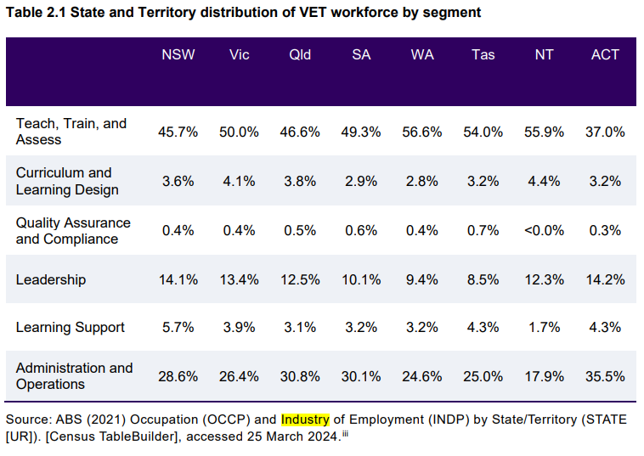
VET Workforce Blueprint
VET is only slightly more
feminised and slightly less culturally diverse that the wider Australian workforce.
Notes:
Categories down the left are based on the JSA VET Workforce Taxonomy which is described in the VET Workforce Study

Slide 29
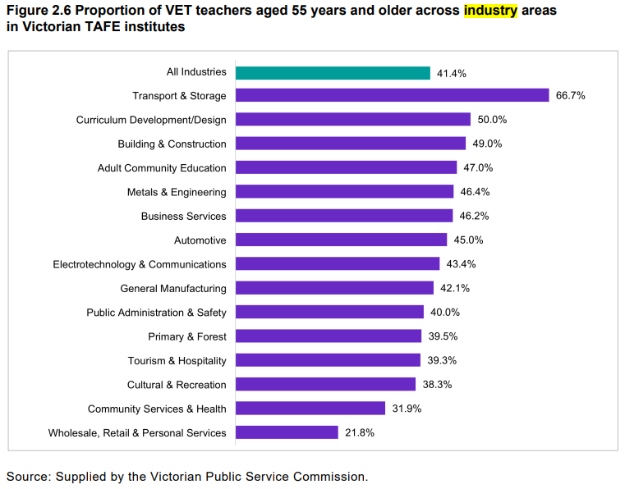
VET Workforce Blueprint
The VET workforce, especially the Teach, Train and Assess segment of the workforce, is older and ageing.
Almost half of the VET workforce is over 50 years, and the average age is seven years older than the Australian workforce average (47 compared to 40).
Data shows that for TAFE Victoria at least, certain industry and operational areas also have a high percentage of teachers aged 55 and older, especially among building and engineering trades, adult community education and automotive, see Figure 2.6
Notes:
Possible explanation for the older teaching workforce is that VET teachers typically have industry careers and experience before entering VET. Also reflected in students undertaking TAE at the Certificate IV and Diploma levels are generally older than students undertaking those qualification levels overall.
58.3% of VET teachers (ANZSCO Vocational Education Teachers) employed in public providers are over 50 years old, compared to 48.7% in private providers.

Slide 30
Next Steps
Stream 1: Understand – Activity approved by DEWR
Quantitative Data Analysis - Desktop research using JSA VET Workforce Study, ANZSCO and ANZSIC classifications, and other data sources.
Analysis of workforce roles, trends, and industry challenges in the mining and automotive sectors.
Qualitative Data Collection - Conduct job shadowing/observation with VET practitioners and industry experts. Conduct interviews with key VET staff, new VET workforce members, current students and industry experts. Hold virtual roundtables with stakeholders from the mining and automotive sectors.
Draft Report - May 2025
Final Report - 13 June 2025
Streams 2 & 3 be informed by the findings of Stream 1 and will likely focus on:
Attract & Retain, and
Grow
Notes:
As mentioned earlier, the Federal Government has commissioned all JSCs to undertake the VET Workforce Blueprint project for their specific industries. This work is being undertaken with funds provided above and beyond our normal funding envelope.
All states and territories
Going out to industry in Feb 25 in 6 states and territories.
Into the RTO to gather the missing info and data/de-identified.

Slide 31
How can you help?
Provide access to staff.
Tell us about models that you have seen work well e.g. release industry experts; allow VET trainers access to your business to support industry currency.
Think about how the industry can support the VET Workforce to ensure it has the workers it needs for the future.
Participate in the virtual roundtables, interviews, etc., as appropriate.
If you can see some barriers to supporting the VET workforce, what do you think are the solutions?
Email: simon.hester@ausmasa.org.au Tel: 0414 715 297
Notes:
On different indicators (average income and median earnings) the VET workforce is generally paid more than the Australian workforce but less than their counterparts in other education industry sectors and/or other teaching occupations. The average annual income for the VET workforce is 8.1% higher than the Australian workforce average at $81,245 compared to $74,679, see Table 2.8.
Report notes gender pay gap issues.
TAFE/public provider staff are generally more highly paid and are more educated than in the private RTOs. Largely due to greater unionization and EBA’s paying higher than the sector award.
Though TAFE are still paid less than other education workers such as those in secondary sector or universities.

Slide 32
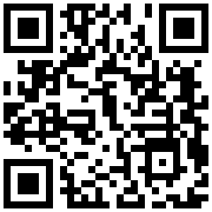
Get Involved
AUSMASA.ORG.AU
Subscribe
Free Membership
Events
SOCIAL MEDIA
32
Notes:
Title only slide (white background), for use when you have an image or something similar that requires the whole slide.

Slide 33
THANK YOU
Notes:
Title Slide – Design F
Inputs:
Title
Subtitle
Presenter Name
Date

