Slide 1


Electric Vehicle Package

Slide 2
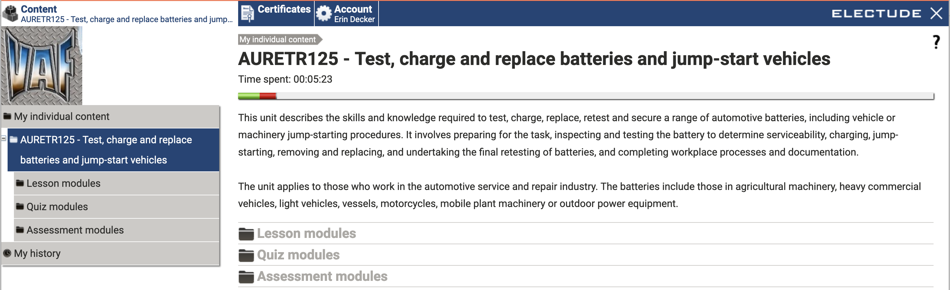

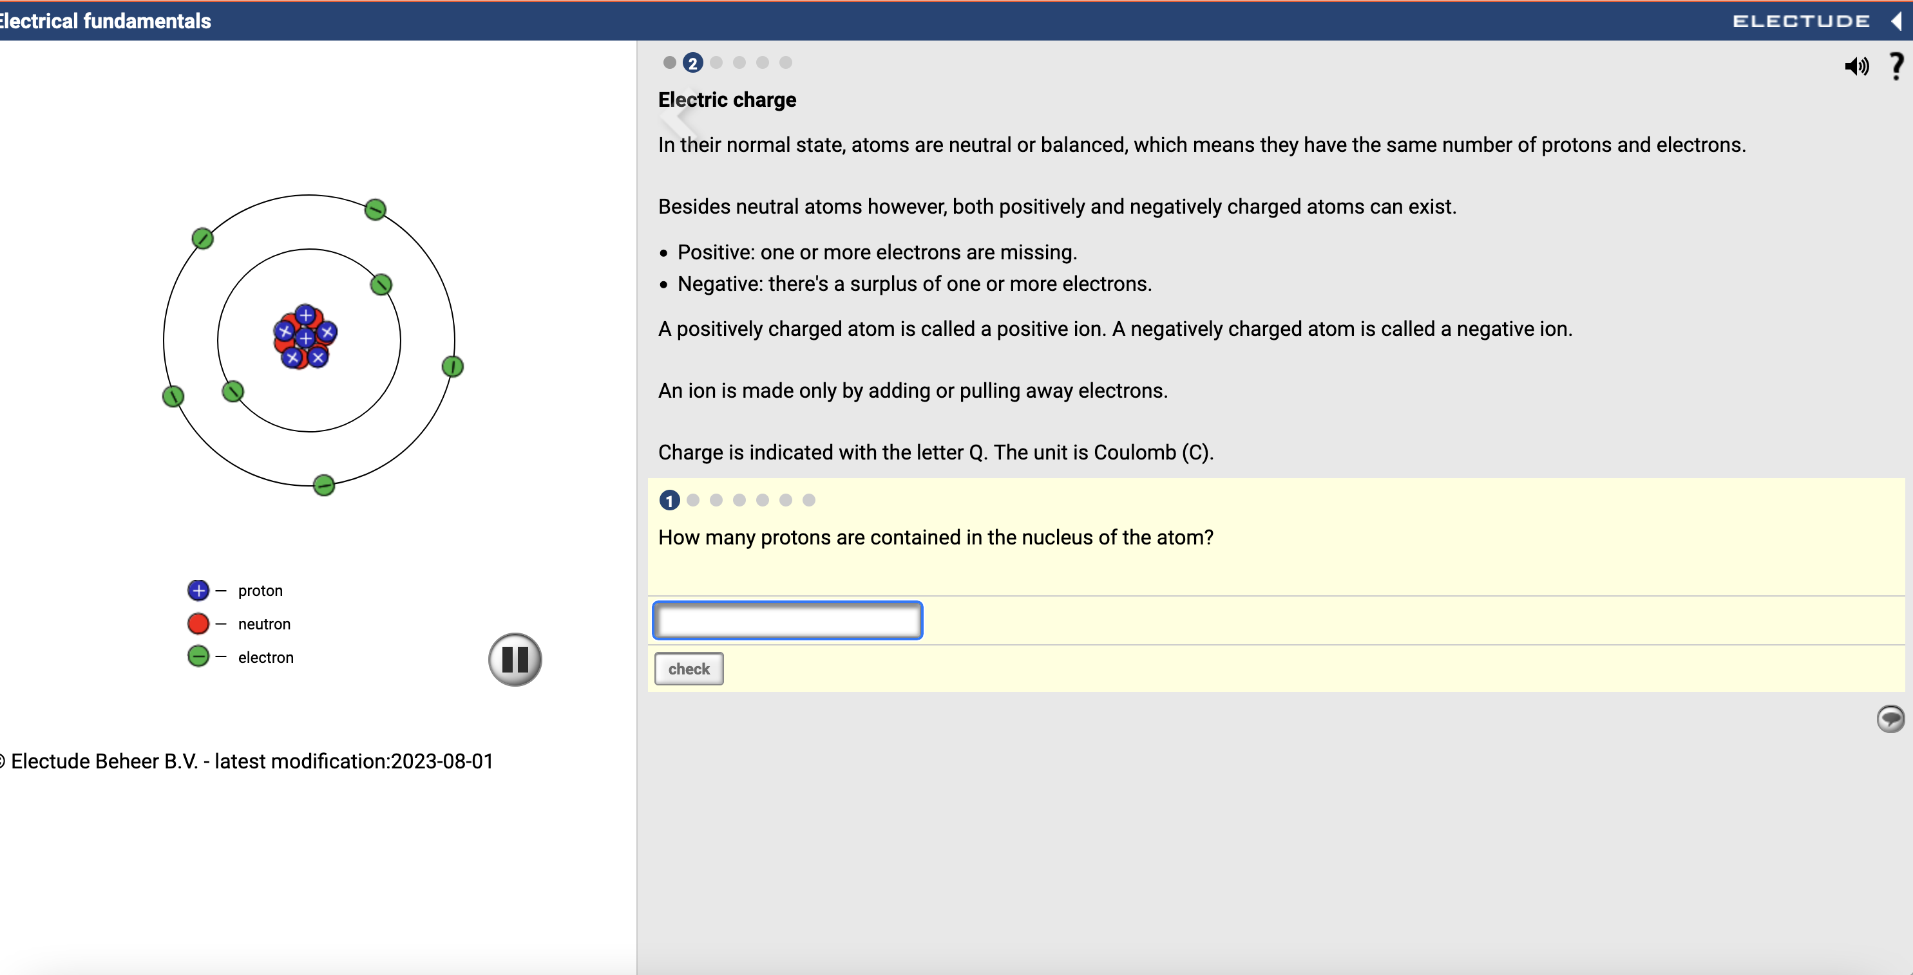
Classroom for AUR32721
  Learning materials mapped to the Knowledge Evidence in the AUR National Training Package’s UoCs
  Discovery based learning content
                Engine management simulations
            How-to videos
            Virtual labs
  Printable student companion guide
  Self evaluation questions
  Summative assessments
  Mapping documentation/guides
  Continually updated content & mapping as UoCs are updated or new qualifications are released

Slide 3

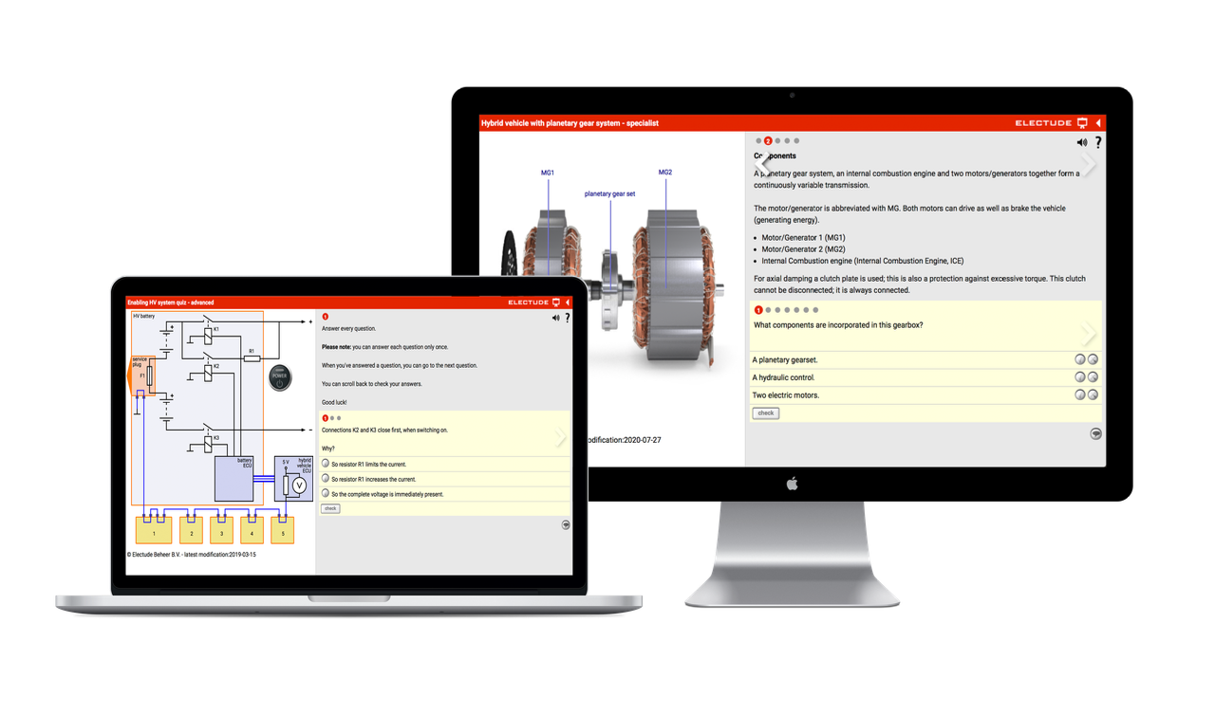

Classroom for BEV Skill Sets
AURSS00063 Diagnose & Repair & AURSS00064 Inspect & Service
Everything you need to deliver the BEV Skill Sets, from theoretical curriculum to practical assignments and knowledge assessments:
Learning materials mapped to Knowledge Evidence
Practical assignments mapped to Performance Evidence
Summative & formative assessments
Diagnostic Flowchart
Diagnosis Form
Notes:
The product offering for the Skill Sets includes additional features to Cert III
+ practical assignments
+ summative assessments

Slide 4





Help Needed: Review & Validation
Content Mapping
Review
Updates
Validation
Ready!
Electude conducts the first round of mapping, aligning our extensive library of content and digital tools to the AUR UoCs
A team of Australian teachers and SMEs review Electude’s content and mapping using a Validation Tool
Electude makes updates to content and/or mapping based on the feedback received.
This may include content localisation, content development or mapping updates
Content and mapping is reviewed once more.
If the required updates have been made, or planned for in upcoming releases, the Australian teacher will validate that Classroom meets Australian requirements
Electude Classroom is available for Australian RTOs to use in the teaching & delivery of their automotive course(s)

Slide 5

Thank You

